Slide 1
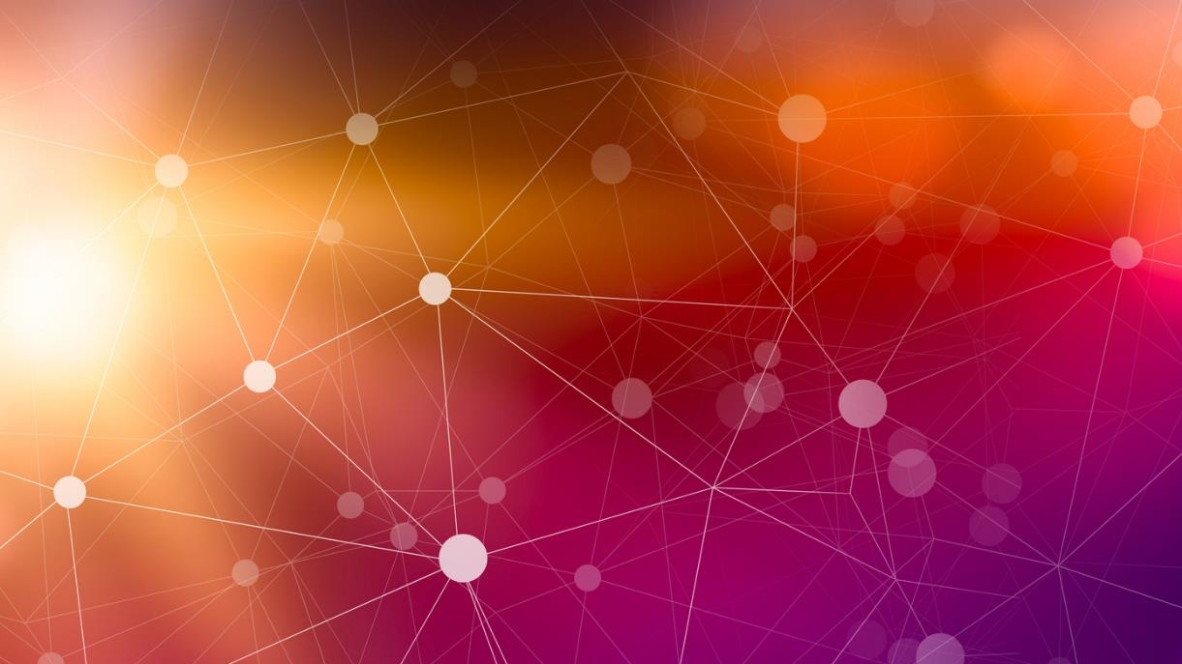
DDD and Event Sourcing

Slide 2
Domain Events Bringing EDA to the Solution Level
Notes:
Domain Events come from DDD
It’s how we bring EDA down to the solution level
They are what make Event Sourcing “Practical”
You can do Event Sourcing w/o DDD, but it’s a lot more “messy” and less explicit

Slide 3
What is a Domain Event?
Immutable representation of something that has happened in the past that can be used to trigger additional behavior (side-effects) within the same domain that the event was raised in.

Slide 4
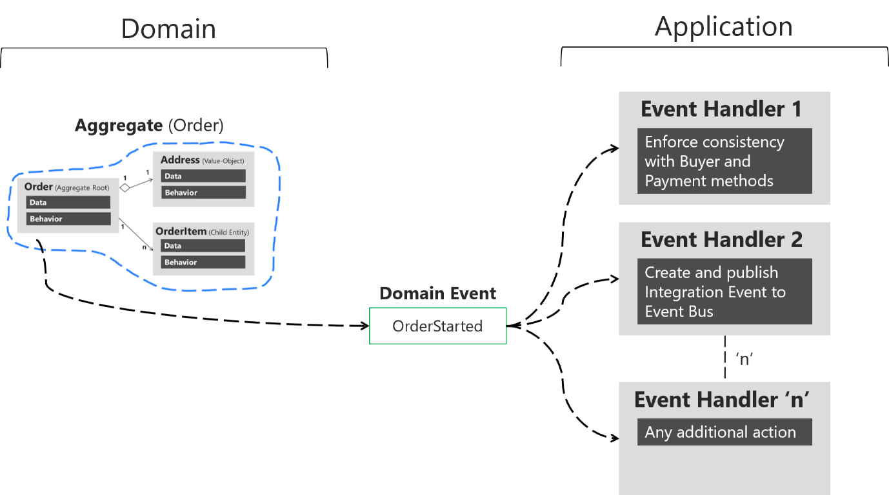
Domain events: Design and implementation - .NET | Microsoft Learn
Notes:
User sends a request or command to “start” an order
That Order then creates and raises an “OrderStarted” event WITHIN the domain, typically using something like MediatR
Any number handlers, responsible for a single “side-effect”

Slide 5
Why Domain Events?
Decouple “Side-Effects” from the Original Command (SRP)
Additional behaviors/side-effects are more explicitly modeled
Extensibility – New features can be introduced w/o modifying existing code (Open/Closed Principle)
Sets us up beautifully for Event Sourcing
Notes:
As additional business rules and side-effects grow, are code becomes tightly glued together and a single class becomes responsible for handling all these additional behaviors, violating SRP
2. Clearly understand the “consequences” of a command or request

Slide 6
Why Domain Events?
Decouple “Side-Effects” from the Original Command (SRP)
Additional behaviors/side-effects are more explicitly modeled
Extensibility – New features can be introduced w/o modifying existing code (Open/Closed Principle)
Sets us up beautifully for Event Sourcing
Notes:
As additional business rules and side-effects grow, are code becomes tightly glued together and a single class becomes responsible for handling all these additional behaviors, violating SRP
2. Clearly understand the “consequences” of a command or request

Slide 7

Event Sourcing

Slide 8
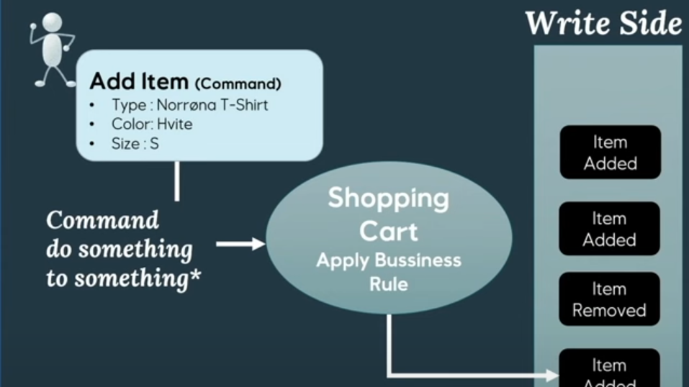
Event Sourcing – the what, why & how - Anita Kvamme - NDC Oslo 2024 (youtube.com)
Notes:
Anita Kvamme – Stole some of her slides, Best talk I’ve ever seen on Event Sourcing
Issue a command -> Validate Business Rules -> Add Event to Event Store (typically a document DB) -> Publish Event
This is where DDD/Domain Events make Event Sourcing much more practical, b/c now we can react to that event

Slide 9
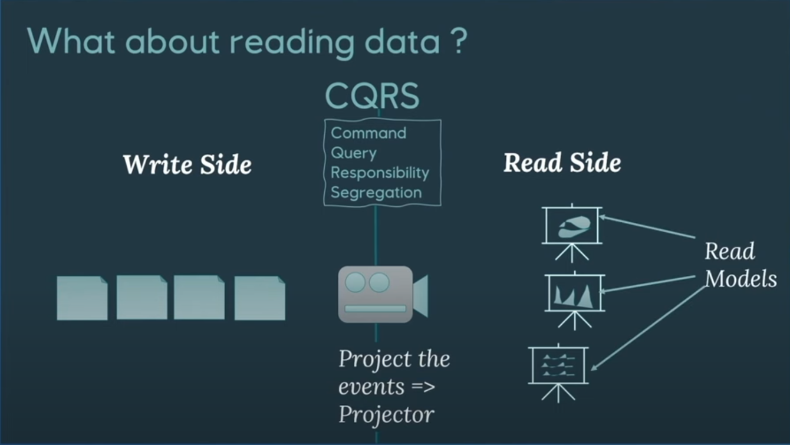
Event Sourcing – the what, why & how - Anita Kvamme - NDC Oslo 2024 (youtube.com)

Slide 10
Why Event Sourcing?
Never lose any data/complete history of aggregate
Tells us how we got to our current state
Easier to extend
New Events
Read Models
Debugging – event stream gives us what changes have been made
In memory read models?

Slide 11
Event Sourcing Challenges
New way of thinking/modeling application. Will be more difficult for new developers
Eventual Consistency
Complexity
Notes:
2. Eventual Consistency – how long can the user go before they see their change? Ways around this. Ex. Show user their change immediately
3. Lot’s more moving parts, harder to see the big picture

Slide 12

Implementation

Slide 13
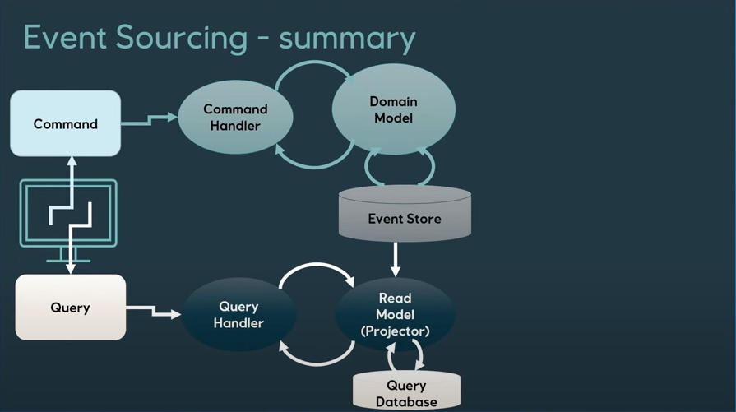
Event Sourcing – the what, why & how - Anita Kvamme - NDC Oslo 2024 (youtube.com)

Slide 14
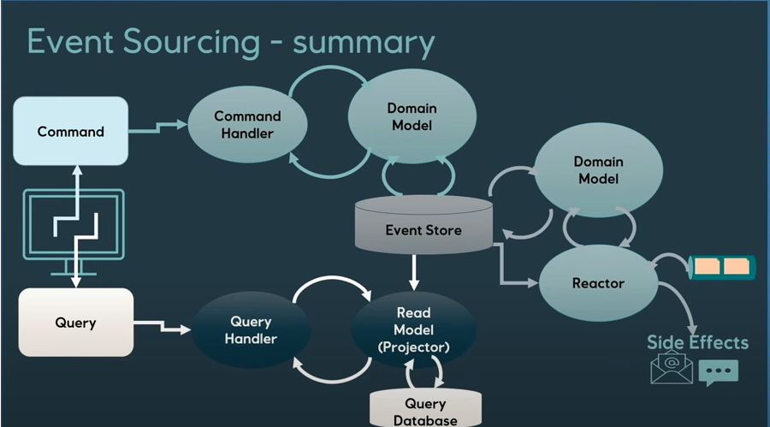
Event Sourcing – the what, why & how - Anita Kvamme - NDC Oslo 2024 (youtube.com)

Slide 15
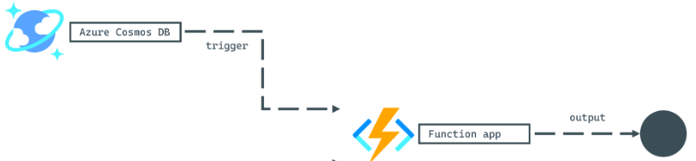
Event Store

Slide 16
Demo

Slide 17

That’s it!

